Slide 1

B.Tech Project Evaluation-2, VIIIth Sem Real-time Vehicle detection and tracking system using
cascade classifier and background subtractor
Presented by :-
Priyanshi Verma – 2018013701
Aprajita Singh – 2018012404
Kajal Verma - 2018013687
Arya Kumar Sundaram - 2018014534
Under the Supervision of:-
( Dr. Vijendra Singh)
Sharda University, Gr. Noida
DEPARTMENT OF COMPUTER SCIENCE & ENGINEERING
SCHOOL OF ENGINEERING AND TECHNOLOGY
Feb 2022
1

Slide 2

Approval from guide

Slide 3
Introduction
In this project, we implemented Cascade Classifier and Background Subtractor approach for detecting vehicles in a real-time video stream and also tracking those vehicles through counting by initiating vehicle counter. We’ve also integrated real-time Frames Per Second (FPS) value for understanding the performance of model on varied hardware systems on the low-specs and high-specs. Furthermore, for validating the efficacy of these models to be integrated into real-time, we also colligate them with different models such as Mobile Net Single Shot Detection (SSD) and Xailient for deep understanding. This analysis gave us an idea that how each model varied over different hardware systems and their stability in terms of efficiency on those systems.

Slide 4
Reason behind the research problem
With the increase in the number of humans. Due to this, we can often see that the roads are jammed due to extensive traffic, increase in accidents, increase in security breaches, etc. Thus, it becomes extremely important for ensuring the safety of human beings and aid the traffic issues, to develop a surveillance system for real ­time. This inhibits the prevention of a life in an ambulance, extrapolates the tendency of increased noise and air pollution, etc. But the major constraint revolves around the hardware requirements of these models. The increment in computational complexity affects the overall performance of any workflow when we consider doing it real-time.

Slide 5
Methodology used for analysis
Haar cascade classifier
It can basically be coined as a series of rescaled ‘square-shaped’ functions which is collated to formulate a family of wavelet.
Basically, it can be subsumed as a Haar Wavelet operation for analyzing pixels present in an image in the form of squares through a function.
The Adaboost algorithm which is utilized for enhancing the learning perspective of a model through the detection of minute features and thereby making the output more efficient is used in Haar Cascades.
Background Subtraction
Background Subtraction is process of detecting foreground from a background. The working of Background Subtraction is incorporated for detection of moving entities over videos captured through static cameras.
With the help of background subtractor, morphology is also induced, which is also an image processing outlook that works on image segmentation for escalating segmentation accuracy.

Slide 6
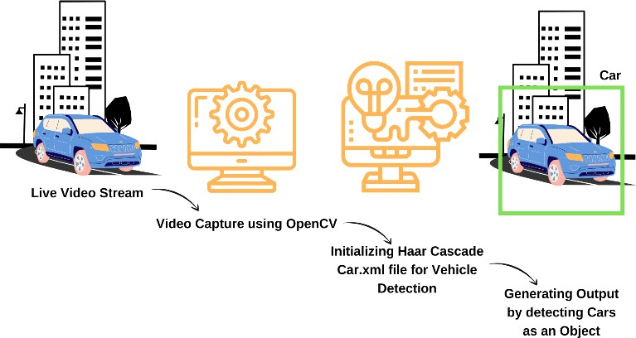
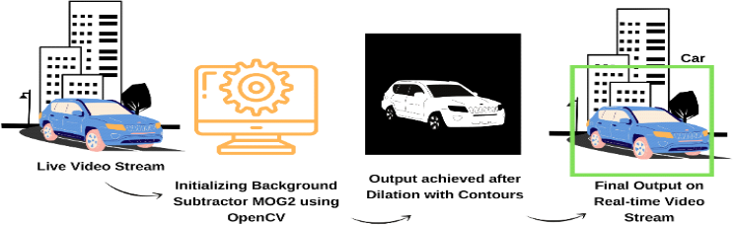
Algorithms implemented
Implementation Flow of Cascade Classifier
Implementation Flow of Background Subtractor MOG2.

Slide 7
Implementation
We aggregated two systems with both lower processing power and high processing power, but both explicated over CPU processing itself and no GPU was utilized.
i] The Low-End System: iball CompBook Pentium Quad Core Processor with Windows 10 Operating System.
ii] The High-End System: Honor Magicbook 15 Ryzen-5 Quad Core 3500U with Windows 10 operating system.

Slide 8
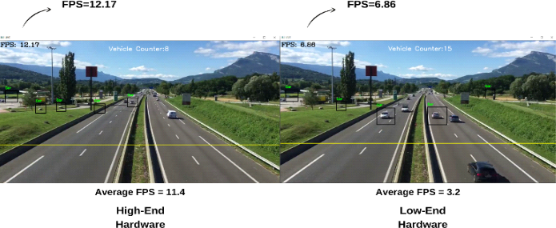
Result And Analysis
We ran the same code over both the systems, we got phenomenal insights.
Figure.1 displays the output results for the Cascade Classifier with Frame Rate and the Vehicle Count in real-time. Similarly

Slide 9
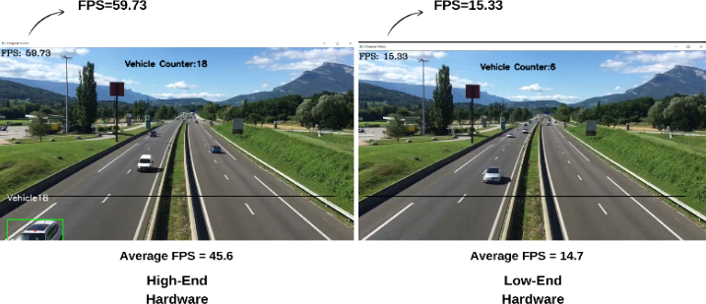
Result And Analysis
Fig. 2. Real-time Output for Background Subtractor MOG2 with FPS and Vehicle Counter

Slide 10
Table 1. Accuracy Illustration
SN | Models | Accuracy( in %)
1. | Casscade Classifier | 92
2. | Background Subtractor MOG2 | 97
Table 2. FPS Value Comparison on High-end Hardware for different models.
Models | Hardware Utilized | Cores Used | FPS Value | CPU Utilization(%)
MobileNet SSD [22] | Honor Magicbook 15 | 4 | 23.3 | 80
Xailient [22] | Honor Magicbook 15 | 1 | 27.3 | 60
Cascade Classifier | Honor Magicbook 15 | 4 | 11.4 | 85
Background Subtractor MOG2 | Honor Magicbook 15 | 4 | 45.6 | 72

Slide 11
Table 3. FPS Value Comparison on Low-End Hardware for different models.
Models | Hardware Utilized | Cores Used | FPS Value | CPU Utilization(%)
MobileNet SSD [22] | Iball CompBook | 4 | 0.8 | 95
Xailient [22] | Iball CompBook | 1 | 8.2 | 75
Cascade Classifier | Iball CompBook | 4 | 3.2 | 94
Background Subtractor MOG2 | Iball CompBook | 4 | 14.7 | 85

Slide 12
Improvement/Work done from the last evaluation
1. Created the model which can do vehicle tracking and detection while analysing the performance and consuming less power of processor to use this in real time.
2. Har Cascade classifier and background subtractor is merged in the model.
3. Phases of haar cascade classifier
The calculation of Haar Features
The creation of integral images
The utilization of Adaboost
Finally, the Implementation of Cascading Classifiers
4. Background Subtractor – the technique used for separating out surrounding elements from the background

Slide 13
Workload distribution of the team
Everyone is contributed for research paper.
TEAM MEMBERS NAME
WORK LOAD
Priyanshi Verma
Worked on data and model.
Aprajita Singh
Worked on coding part and researched on existing algorithms.
Kajal Verma
Worked on coding part and research paper.
Arya Kumar Sundaram
Helped in organizing the documents, charts and diagrams.

Slide 14
FUTURE SCOPE AND CONCLUSION
This analysis can be done for a Traffic Surveillance System in real-time by building prototype. Also, more tuning can be done for optimizing these algorithms for producing higher efficacy.
Helps in decreasing traffic congestion, traveling time, chances of accidents, loss of productivity.

Slide 15

PROOF ATTACHED OF PAPER SUBMISSION

